Slide 1
Information Visualization Session 3: Understand Your Story
Matthias Shapiro
@politicalmath
matthias.shapiro@outlook.com

Slide 2
Agenda
Refine the question based on data
Data visualization styles
Technology and algorithms

Slide 3
You will need: Excel The interwebs

Slide 4
refine the question based on data

Slide 5
data visualization styles

Slide 6
Applying a Visual Metric
Size
Color
Iconography
Location
Networks
Time

Slide 7
Visual Metric - Size
5
1
100

Slide 8
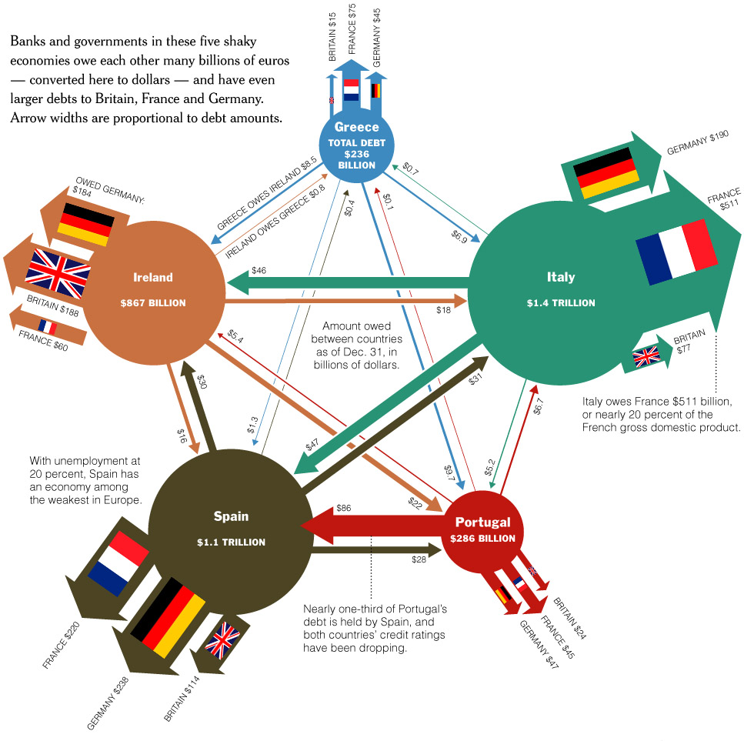
Visual Metric - Size

Slide 9
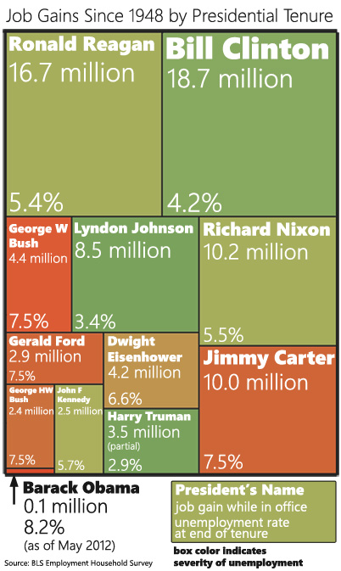
Ways to Show Size
Area (rectangles or circles)

Slide 10
Ways to Show Size
Area (use 2008 presidential viz)

Slide 11
Size tools
Any graphic software (Excel)

Slide 12
Visual Metric – Color
0
50
100

Slide 13
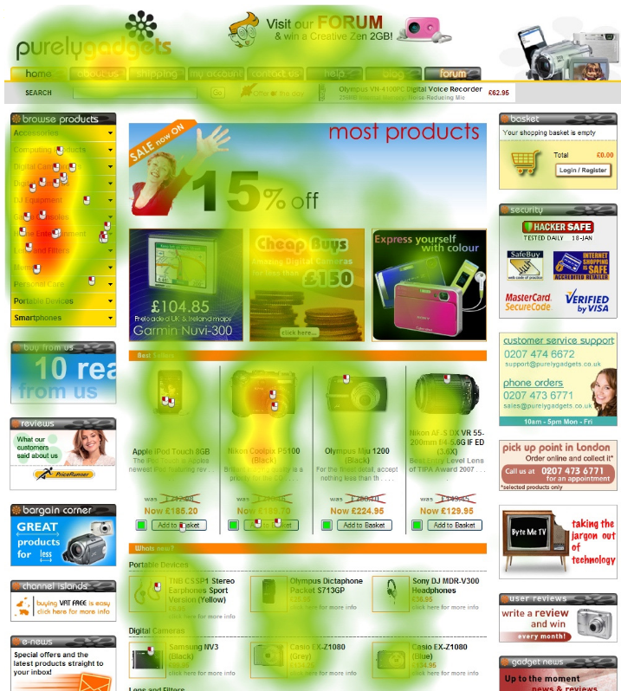
Visual Metric – Color
Gradient colors
Red-yellow-green
Red-blue
Shaded (light-to-dark)

Slide 14
Picking the right range
53
Not good for data with subtle value variation
46
Colors can wash out or change depending on display
0
100

Slide 15
Picking the right range
Not good for data with subtle value variation
53
Colors can wash out or change depending on display
46
40
60

Slide 16
Picking the right range
Not good for data with subtle value variation
53
Colors can wash out or change depending on display
46
40
60

Slide 17
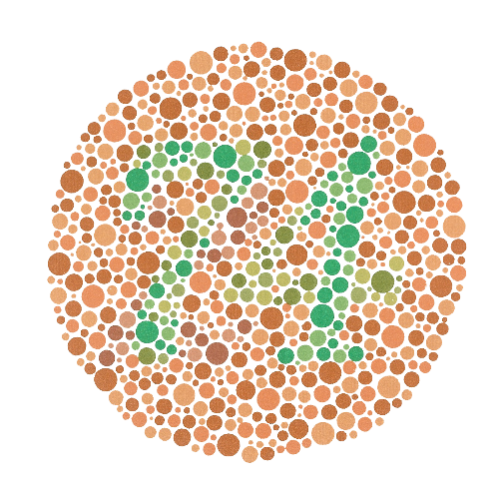
Picking the right range
4-5% of viewers are colorblind
0
50
100

Slide 18
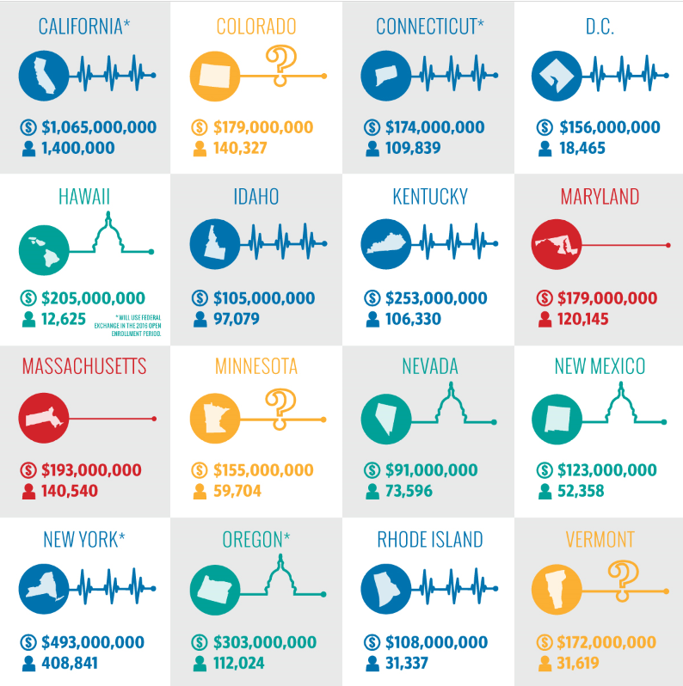

Visual Metric – Color
Color “buckets”
http://dailysignal.com/2015/06/08/how-the-16-state-exchanges-are-faring-under-obamacare/

Slide 19
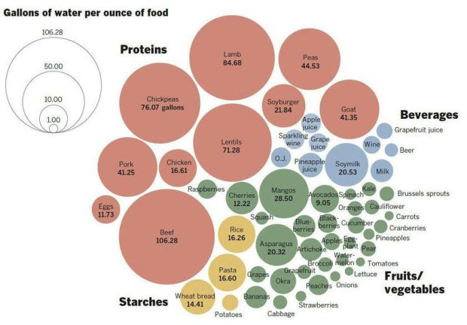
http://flowingdata.com/2015/04/07/gallons-of-water-to-produce-foods/

Slide 20
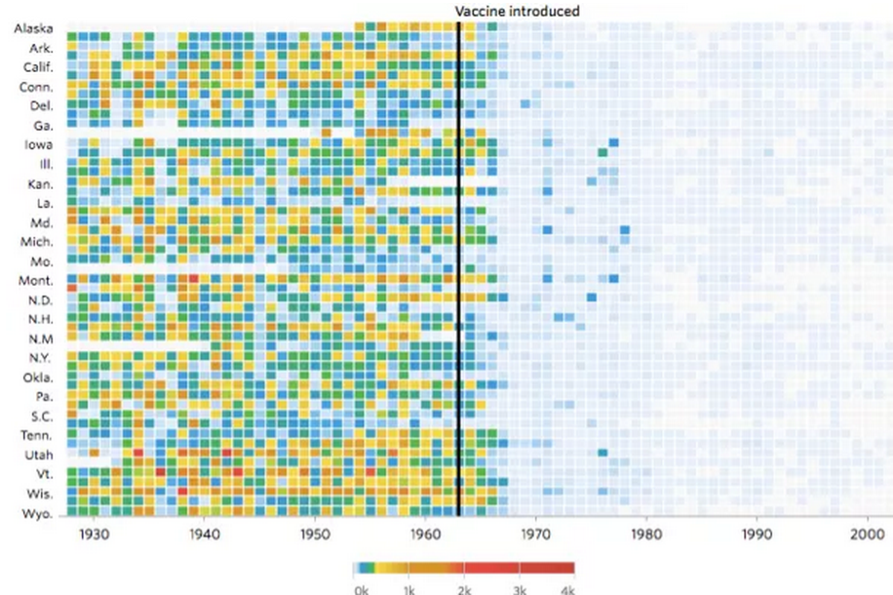
http://graphics.wsj.com/infectious-diseases-and-vaccines/

Slide 21
Color Metric Tools
List of color tools
Excel helper

Slide 22
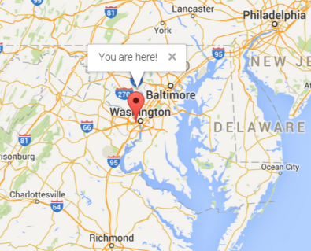
Visual Metric - Locations

Slide 23
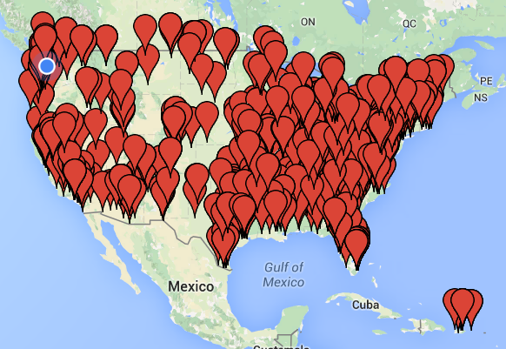
Visual Metric - Locations

Slide 24
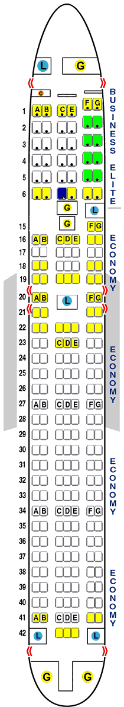
Visual Metric - Locations
Data mapped to any corresponding physical dimension
http://seatguru.com

Slide 25
Location Tools
Google Maps

Slide 26




Visual Metric - Networks

Slide 27
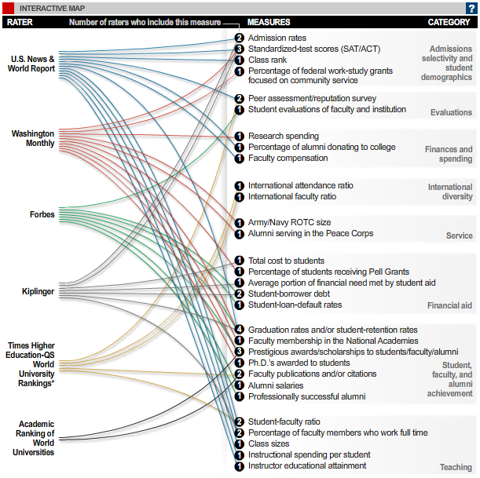
Visual Metric - Networks
Show connections between data points based on some true/false statement

Slide 28
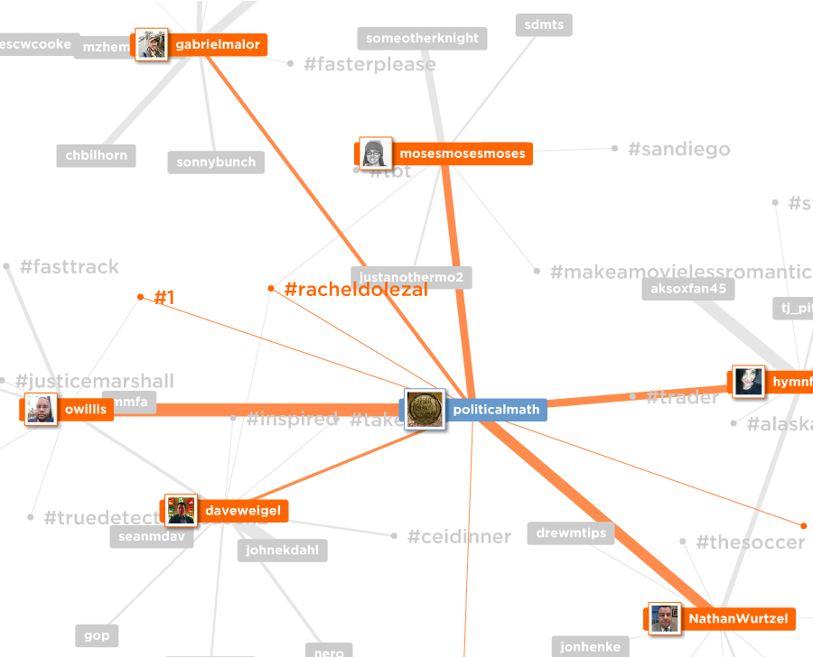
Visual Metric - Networks
force directed graph drawing
mentionmapp.com

Slide 29
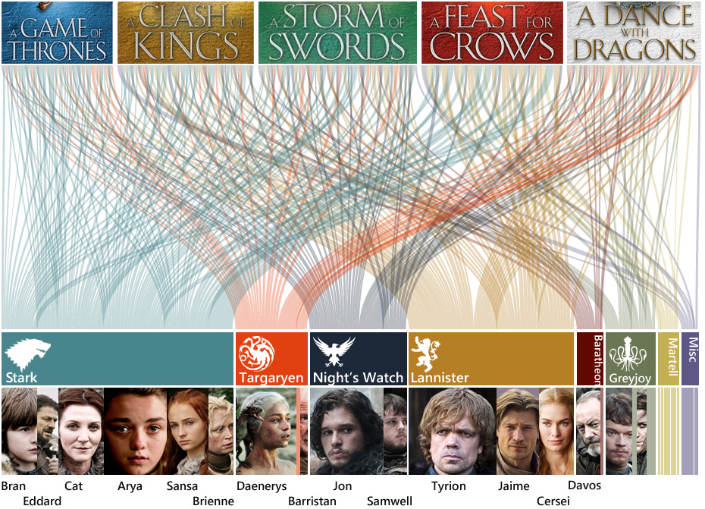
Visual Metric - Networks

Slide 30
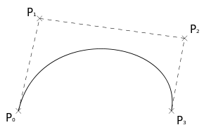
Visual Metric - Networks
Creating a bezier curve for networking visuals
x1,y1 – start point (P0)
x2,y2 – control point 1 (P1)
x3,y3 – control point 2 (P2)
x4,y4 – end point 1 (P1)

Slide 31
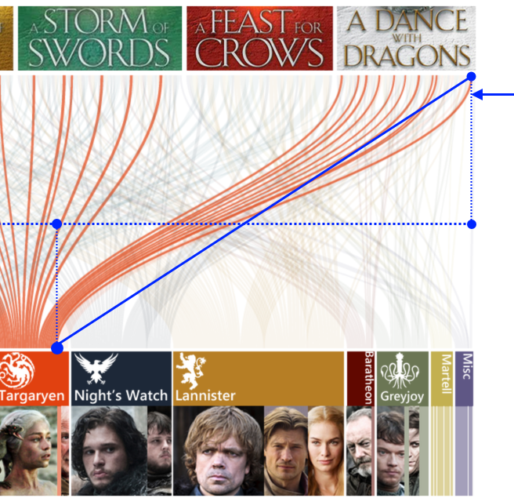
Visual Metric - Networks
Creating a bezier curve for networking visuals

Slide 32
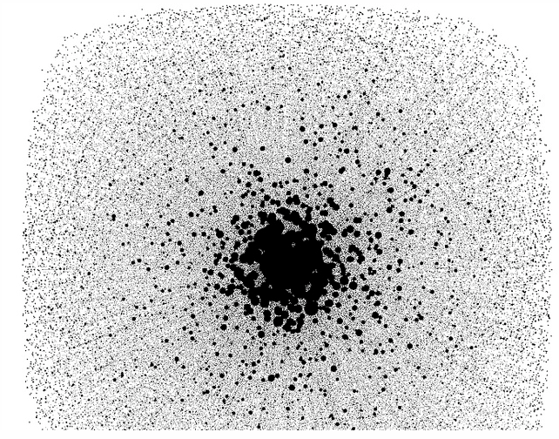
Visual Metric - Networks
limited when data set becomes too large
(1000’s of data points)

Slide 33
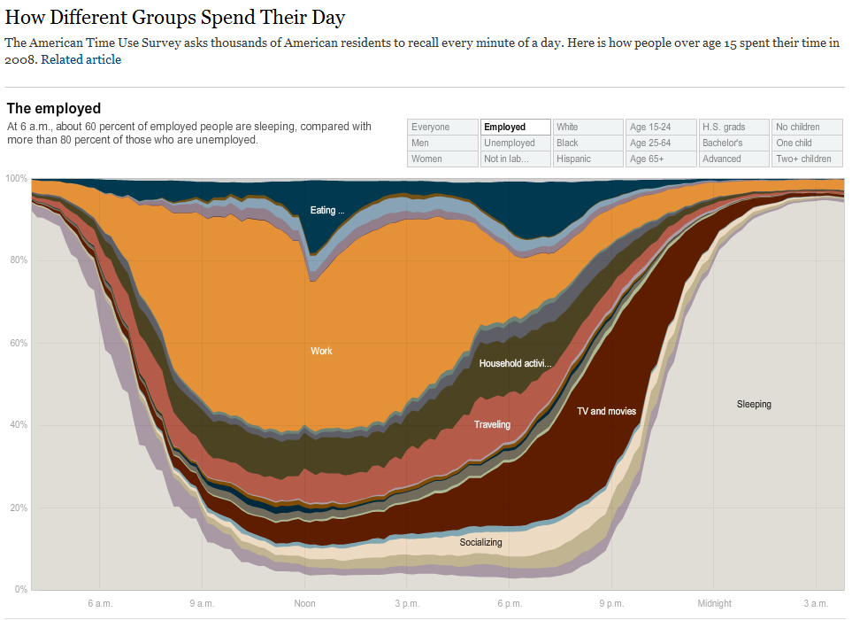
Visual Metric - Time
Data over time, expanded or contracted

Slide 34
Visual Metric - Time
Using animations to expand or contract time

Slide 35
Using Multiple Metrics
Layering visual metrics to create multiple dimensions of meaning

Slide 36
technology and algorithms

Slide 37
Excel + Photoshop
Creating a bezier curve for networking visuals

Slide 38
Processing
Creating a bezier curve for networking visuals

Slide 39
Processing.js
Khan Academy
https://www.khanacademy.org/computing/computer-programming

Slide 40
d3.js
Javascript library for visualization
Used by New York Times visualization team

